Slide 1
A core Course on Modeling
Introduction to Modeling
0LAB0 0LBB0 0LCB0 0LDB0
c.w.a.m.v.overveld@tue.nl
v.a.j.borghuis@tue.nl
S.10

Slide 2
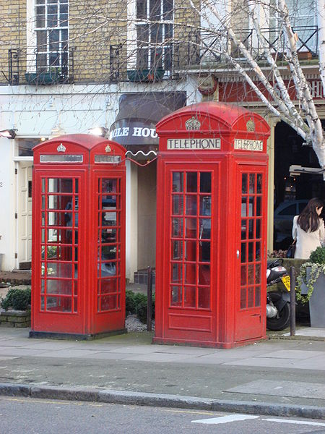
u₁, u₂ constant ratio p₁₂
→ x₁ , x₂ can be converted
set convertible units → dimension
http://commons.wikimedia.org/wiki/File:Big_and_small_red_phonebox.jpg
{m, inch, light year, yard, μm, …}
defines ‘length’ [L];
{sec, year, day, …}
defines ‘time’ [T].
Non-convertible units (e.g., ‘nr. sheep’) …
… give rise to dimensions on their own [SHEEP]
Notes:
2
‘Constant’ means: not depending on the measurement
For units u₁, u₂ with constant ratio , the x₁ and x₂ can be converted
A set of convertible units defines a dimension (equivalence class)
{m, inch, light year, yard, μm, …} defines ‘length’ [L];
similar {sec, year, day, …} defines ‘time’ [T].
There are units that canot be converted (e.g., ‘nr. sheep’). They give rise to dimensions on their own [SHEEP]

Slide 3
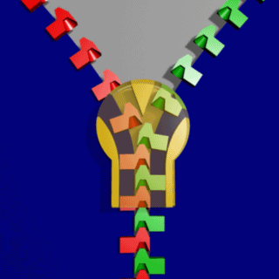
units ‘go with the math’
→ dimensions ‘go with the math’
different dimensions:
not + or -, hence not equated
(a=b → a-b=0)
http://commons.wikimedia.org/wiki/File:Zipper_animated.gif
like a zipper, every dimension
must match left and right from ‘=‘
dimension analysis: check formula
dimension synthesis: construct formula
Notes:
3

Slide 4
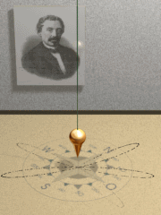
Dimensional synthesis:
Oscillation time T [T] of
pendulum could depend on
g [LT⁻²], m[M], l[L] :
T ∼ m^{α}l^{β}g^{γ}
[T]=[M]^{α}[L]^{β}[LT⁻²]^{γ}
=[M]^{α}[L]^{β+γ}[T]^{-2γ}
http://commons.wikimedia.org/wiki/File:Foucault_pendulum_animated.gif
So: M: α=0; L: β+γ=0; T:1= -2γ
or: T²/(l/g) is dimensionless: T² is proportional to l/g.
Notes:
4

Slide 5
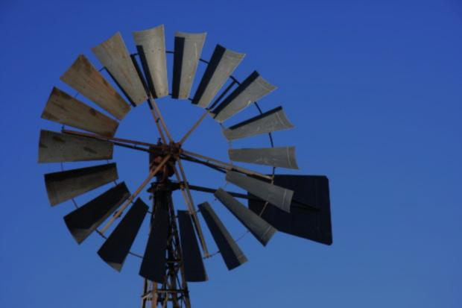
Dimensional synthesis:
Wind force F_{W} could depend on ρ [M/L³ ], v [L/T], A [L²]:
http://www.morguefile.com/archive/display/213367
Notes:
5

Slide 6
Dimensional synthesis:
Wind force F_{W}could depend on ρ [M/L³ ], v [L/T], A [L²]:
QUIZ
Derive a formula for wind force using dimensional synthesis
http://www.morguefile.com/archive/display/213367
Notes:
6

Slide 7
Dimensional synthesis:
Wind force F_{W}could depend on ρ [M/L³ ], v [L/T], A [L²]:
http://www.morguefile.com/archive/display/213367
F_{w} ∼ ρ^{α} v^{β} A ^{γ}
[ML/T²]=[M/L³]^{α} [L/T]^{β} [L²]^{γ}
[M][L][T]⁻²=[M]^{α}[L]^{-3α+β+2 γ} [T]^{-β}
So: M: 1 = α; L: 1 = -3α+β+2γ; T: -2= - β
or: F_{w}/(ρv²A) is dimensionless: F_{w} is proportional to ρv²A.
Notes:
7

Slide 8
Summary:
units with constant ratio → convertible
set of convertible units: dimension
examples: length, time, weight, ...
in any formula, dimensions left and right must be identical
dimensional analysis: check
dimensional synthesis: construct
dimensional synthesis will not yield formulas with + , - and dimensionless factors
Notes:
8

